Slide 1
Understanding The Scriptures
Acts 8:26-31

Slide 2
Understanding Needs ...
Desire
Acts 8:28-31
1Peter 2:2
John 7:17
Matthew 5:6

Slide 3
Understanding Needs ...
Desire
Attitude
Acts 8:34
Acts 26:9
Acts 26:19-20

Slide 4
Understanding Needs ...
Desire
Attitude
Instruction
Acts 8:30
Romans 10:14
Acts 16:14
Matthew 11:29
Acts 17:11
2Timothy 2:15

Slide 5
Understanding Needs ...
Desire
Attitude
Instruction
Background
Acts 8:35
Hebrews 5:12
1Corinthians 3:1-3

Slide 6
Understanding Needs ...
Desire
Attitude
Instruction
Background
Study
Acts 8:34
James 1:5-8
2Timothy 2:15

Slide 7
Understanding Needs ...
Desire
Attitude
Instruction
Background
Study
Practice
Acts 8:36-38
Luke 6:46
Matthew 7:21

Slide 8
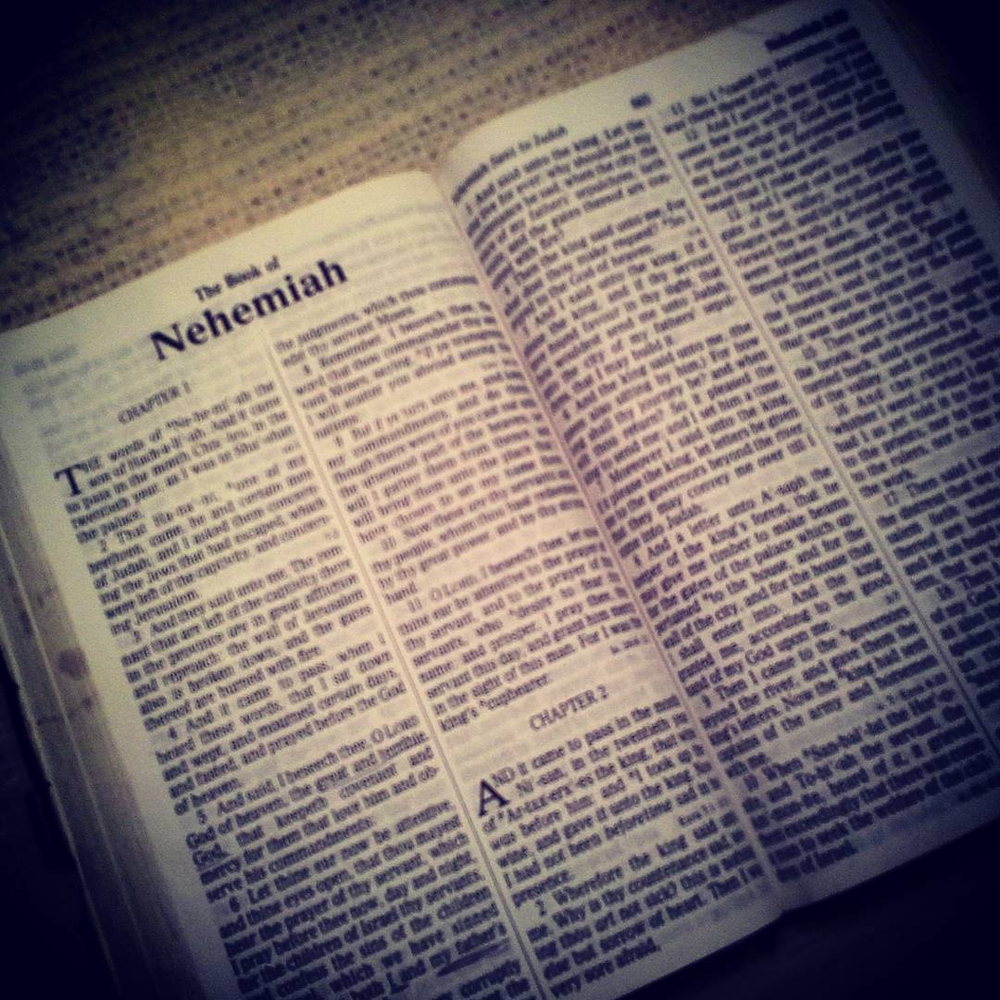
Understanding The Scriptures
Desire
Attitude
Instruction
Background
Study
Practice

