Slide 1
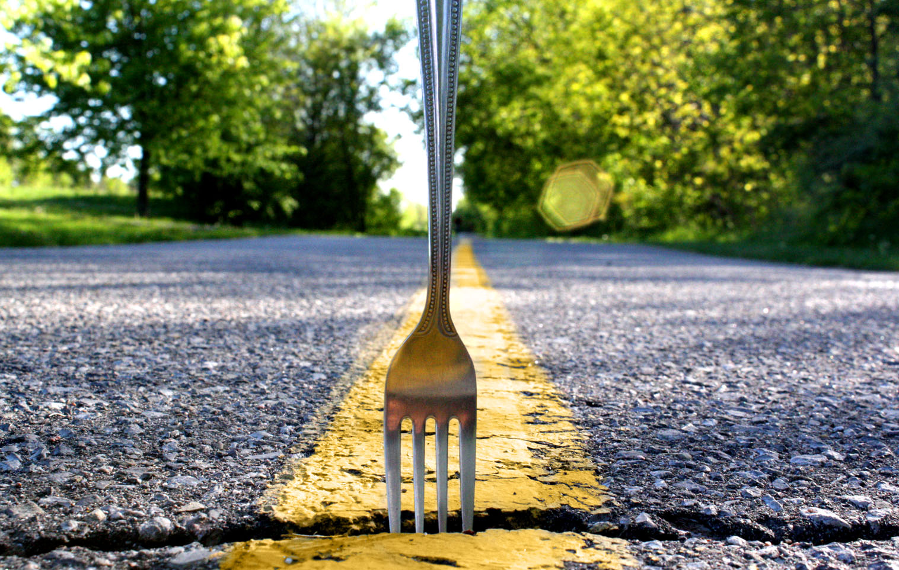
A Fork In The Road
Hebrews
11:24-26

Slide 2
Decisions, Decisions, Decisions...
Constants
Luke 11:24-26
Romans 6:11-13,19

Slide 3
Decisions, Decisions, Decisions...
Constants
Costs
1John 2:17
2Peter 3:10-12
2Timothy 3:12
1Peter 2:19-20

Slide 4
Decisions, Decisions, Decisions...
Constants
Costs
Considerations
1Peter 1:3-5; 2Peter 1:1-4
Hebrews 5:14
2Corinthians 5:1
Luke 12:19-20
Colossians 3:1-3; 1Peter 1:13
2Corinthians 4:17; Romans 8:18

Slide 5
Decisions, Decisions, Decisions...
Constants
Costs
Considerations
Outcome
Deuteronomy 34:10-12
Matthew 17:3

Slide 6
Decisions, Decisions, Decisions...

