Slide 1
The Church
Ephesians 1:22-23

Slide 2

The Church
Matthew 13:45-46
Ephesians 5:25

Slide 3

The Church
1Peter 2:5
1Corinthians 14:40
Titus 1:5

Slide 4

The Church
1Timothy 3:15

Slide 5

The Church
1Peter 5:2-3
1Peter 2:25

Slide 6
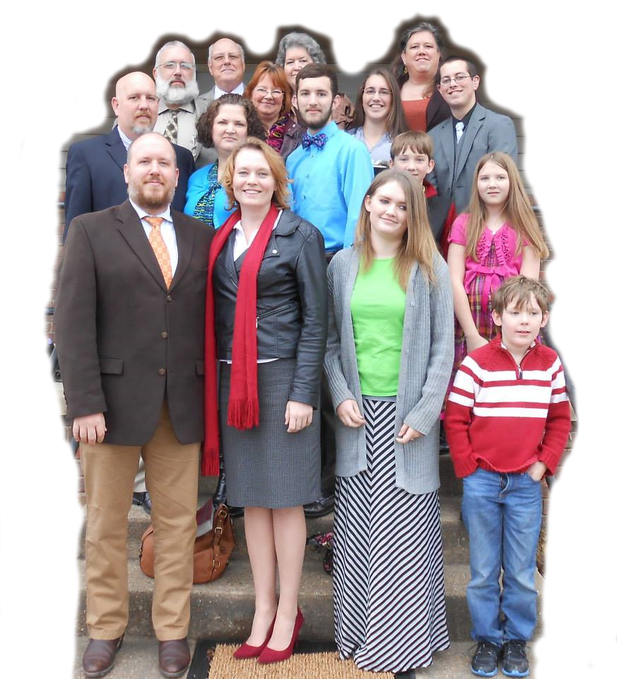
The Church
Ephesians 3:14-15

Slide 7

The Church
Ephesians 1:22-23

Slide 8

The Church
Revelation 1:12-13
Philippians 2:15

Slide 9

The Church
Revelation 19:7-8

Slide 10
The Church

