Slide 1
Clay For The Potter
Jeremiah 18:1-6

Slide 2
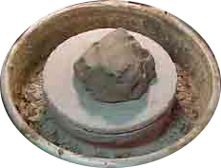
Clay For The Potter
Isaiah 45:9-10
Isaiah 64:8
Romans 12:1-2
Romans 6:16
Ecclesiastes 12:1
Potter

Slide 3
Clay For The Potter
Romans 8:29-30
Colossians 3:10
1Peter 2:21-24
Philippians 3:20-21
1John 3:1-3
Potter
Pattern

Slide 4
Clay For The Potter
2Peter 3:9
Luke 22:31-33, 61-62
Mark 16:6-7
Potter
Pattern
Patience

Slide 5
Clay For The Potter
Romans 9:19-24
Ephesians 2:10
2Timothy 2:19-22
Potter
Pattern
Patience
Product

Slide 6
Are You Molding To The Potter’s Will?

