Slide 1
What Kind Of Church Member Are You?
Revelation 3:1-4

Slide 2
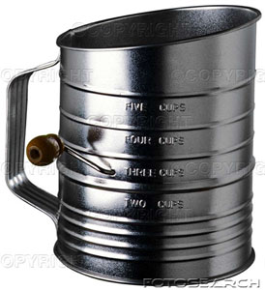
These Are Troublesome
Sifter
1Thessalonians 5:21-22

Slide 3
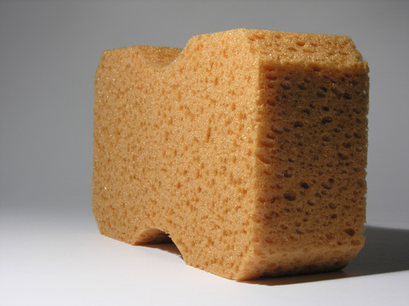
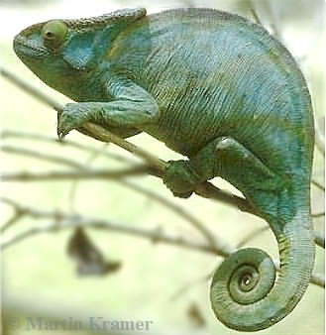
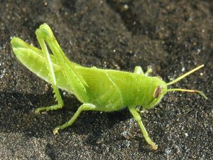
These Are Troublesome
Sifter
Sponge/Chameleon
Grasshopper
Ephesians 4:14-16

Slide 4
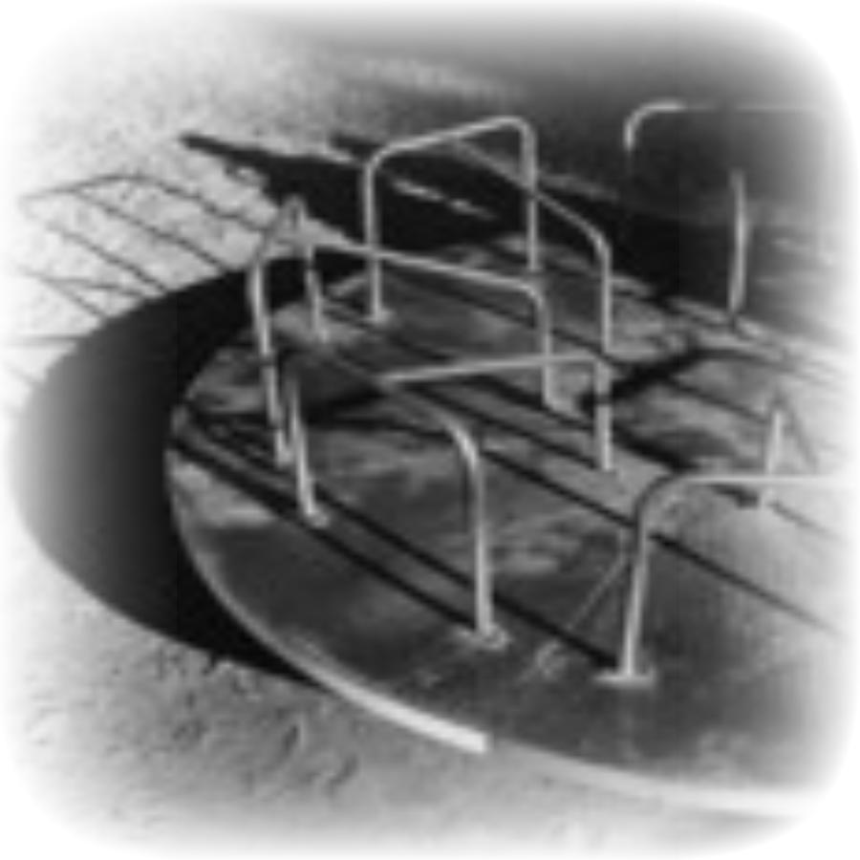
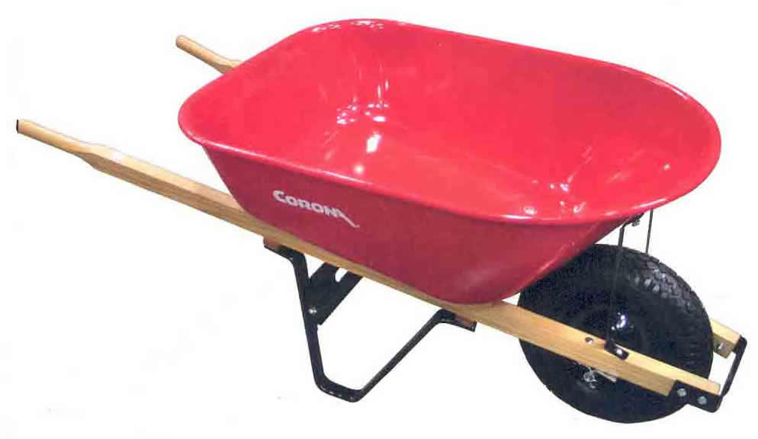
These Are Troublesome
Sifter
Sponge/Chameleon
Grasshopper
Merry-go-round
Wheelbarrow
1Corinthians 15:58

Slide 5
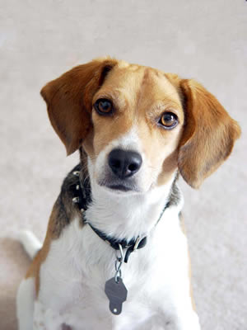
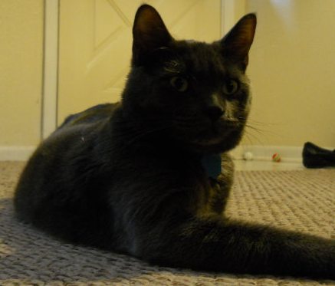
These Are Troublesome
Sifter
Sponge/Chameleon
Grasshopper
Merry-go-round
Wheelbarrow
Pet
Hebrews 5:11-14
1Corinthians 3:1-3

Slide 6
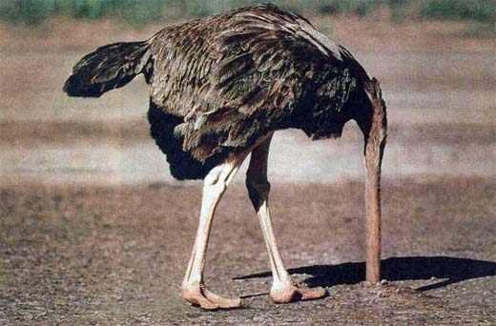
These Are Troublesome
Sifter
Sponge/Chameleon
Grasshopper
Merry-go-round
Wheelbarrow
Pet
Ostrich
1Corinthians 5:1-2
Revelation 2:14-15,20

Slide 7
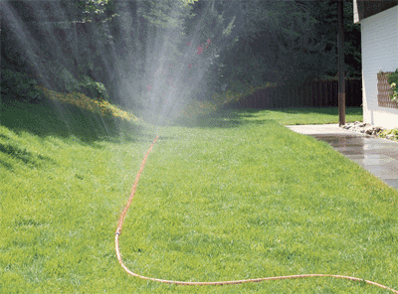
These Are Blessings
Water Hose
1Peter 3:8-9
Proverbs 11:25,30
Proverbs 12:14

Slide 8
These Are Blessings
Water Hose
Ant
Proverbs 6:6-8

Slide 9
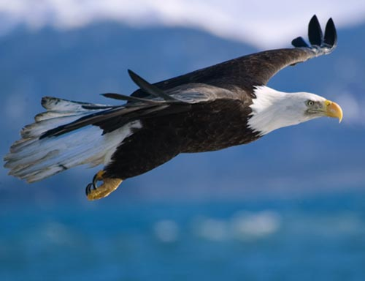
These Are Blessings
Water Hose
Ant
Eagle
Acts 2:14; 4:13; 24:10

Slide 10
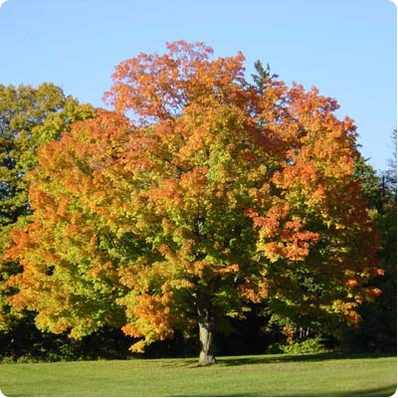
These Are Blessings
Water Hose
Ant
Eagle
Tree
Psalms 1:1-3

