Slide 1
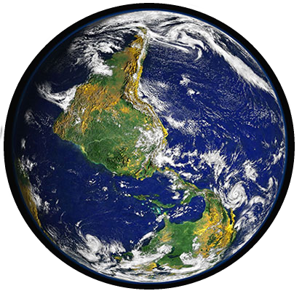
It’s The End Of The World!
1Corinthians 15:22-24

Slide 2
Certain Final Things
Jesus Will Return
1Corinthians 15:22-24
1Thessalonians 4:17
Hebrews 9:28

Slide 3
Certain Final Things
Jesus Will Return
Dead Will Rise
John 5:28-29; 11:24
Acts 24:15
1Thessalonians 4:16

Slide 4
Certain Final Things
Jesus Will Return
Dead Will Rise
All Will Change
1Corinthians 15:50-52

Slide 5
Certain Final Things
Jesus Will Return
Dead Will Rise
All Will Change
Earth Will End
2Peter 3:10

Slide 6
Certain Final Things
Jesus Will Return
Dead Will Rise
All Will Change
Earth Will End
Judgment For All
Hebrews 9:27
Ecclesiastes 12:13-14
2Corinthians 5:10
John 5:22; 12:48
Romans 2:16; 14:11-12
Revelation 20:12-15

Slide 7
Certain Final Things
Jesus Will Return
Dead Will Rise
All Will Change
Earth Will End
Judgment For All
Christ's Reign Finish
1Timothy 2:5-6
1Corinthians 15:25-28

Slide 8
Certain Final Things
Jesus Will Return
Dead Will Rise
All Will Change
Earth Will End
Judgment For All
Christ's Reign Finish
Kingdom Returned to God
1Corinthians 15:24
Matthew 16:18-19
Colossians 1:13
Revelation 1:9-10
John 3:5

Slide 9
Certain
Jesus Will Return
Dead Will Rise
All Will Change
Earth Will End
Judgment For All
Christ's Reign Finish
Kingdom Returned to God
Your
Fate?

