Slide 1
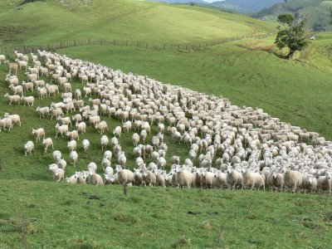
Our Shepherd
Psalm 23

Slide 2
Our Shepherd
Knows & Known – John 10
John 8:31-32; 12:48; 1John 2:24; 1Thessalonians 5:21-22

Slide 3
Our Shepherd
Knows & Known
Leads & Followed – John 10
Luke 6:46; 1John 2:3-6; John 6:68-69

Slide 4
Our Shepherd
Knows & Known
Leads & Followed
Protects & Shelters – John 10
1John 4:4; 3:9; John 14:27-28; 1Peter 1:3-5

Slide 5
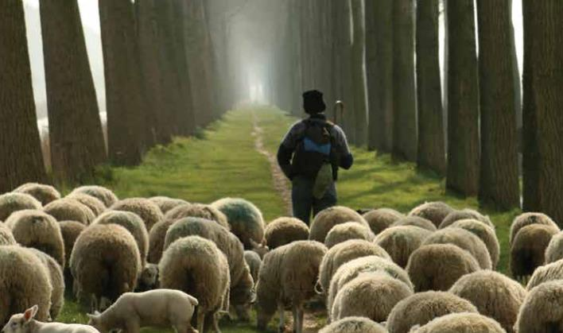
Are You In His Fold?

