Slide 1
Patriarchal Age
2700 Years
4219
BC
2563
BC
2136
BC
1921
BC
1491
BC
Antediluvian
(before the flood)‏
Post-
diluvian
Fathers
of
Israel
Egyptian
Bondage
Genesis
Job?
Creation
Flood
Call of
Abraham
7 Year
Famine
The
Exodus
All dates are approximations
Notes:
Adam, Seth, Noah, Shem, Abraham, Isaac, Jacob

Slide 2
Mosaic Age
1400 Years
1491
BC
1451
BC
Wilderness
Wandering
Exodus
Leviticus
Numbers
Deuteronomy
The
Exodus
All dates are approximations
Notes:
Adam, Seth, Noah, Shem, Abraham, Isaac, Jacob
Moses

Slide 3
Mosaic Age
1400 Years
1491
BC
1451
BC
1400
BC
Wilderness
Wandering
Conquest
of
Canaan
Exodus
Joshua
Leviticus
Numbers
Deuteronomy
The
Exodus
Crossing
Jordan
All dates are approximations
Notes:
Adam, Seth, Noah, Shem, Abraham, Isaac, Jacob
Moses, Joshua

Slide 4
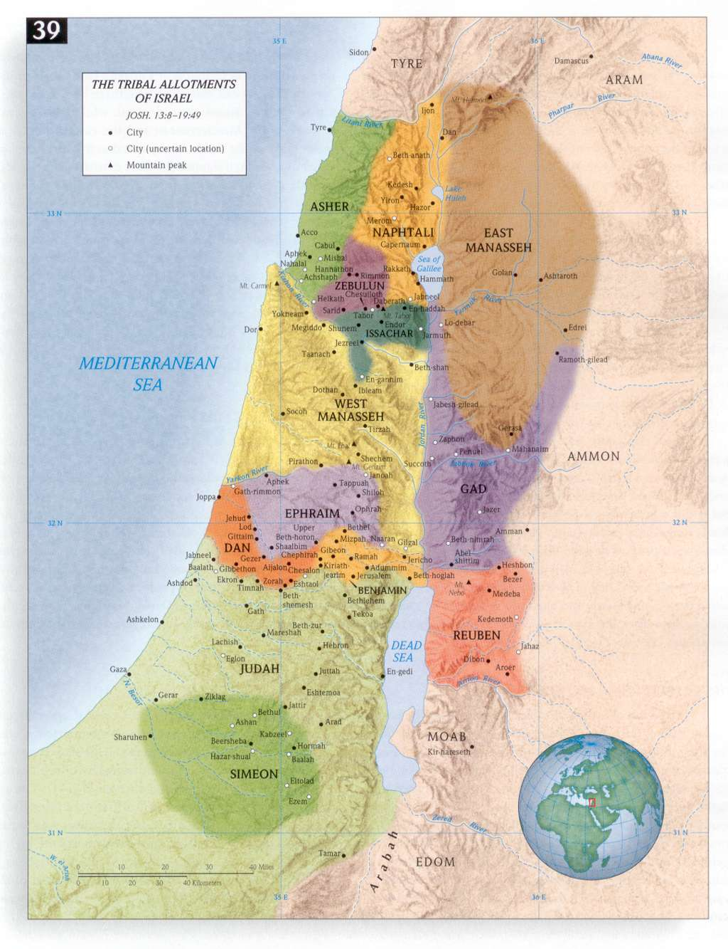

Slide 5
Mosaic Age
1400 Years
1491
BC
1451
BC
1400
BC
1095
BC
Wilderness
Wandering
Conquest
of
Canaan
Period of the Judges
Exodus
Judges
Ruth
1Samuel 1-8
Joshua
Leviticus
Numbers
Deuteronomy
The
Exodus
Crossing
Jordan
All dates are approximations
Notes:
Adam, Seth, Noah, Shem, Abraham, Isaac, Jacob
Moses, Joshua
Othniel, Ehud, Shamgar, Deborah, Gideon, Abimelech, Tola, Jair, Jephthah, Ibzan, Elon, Abdon, Samson, Eli and Samuel
Ruth & Boaz

Slide 6
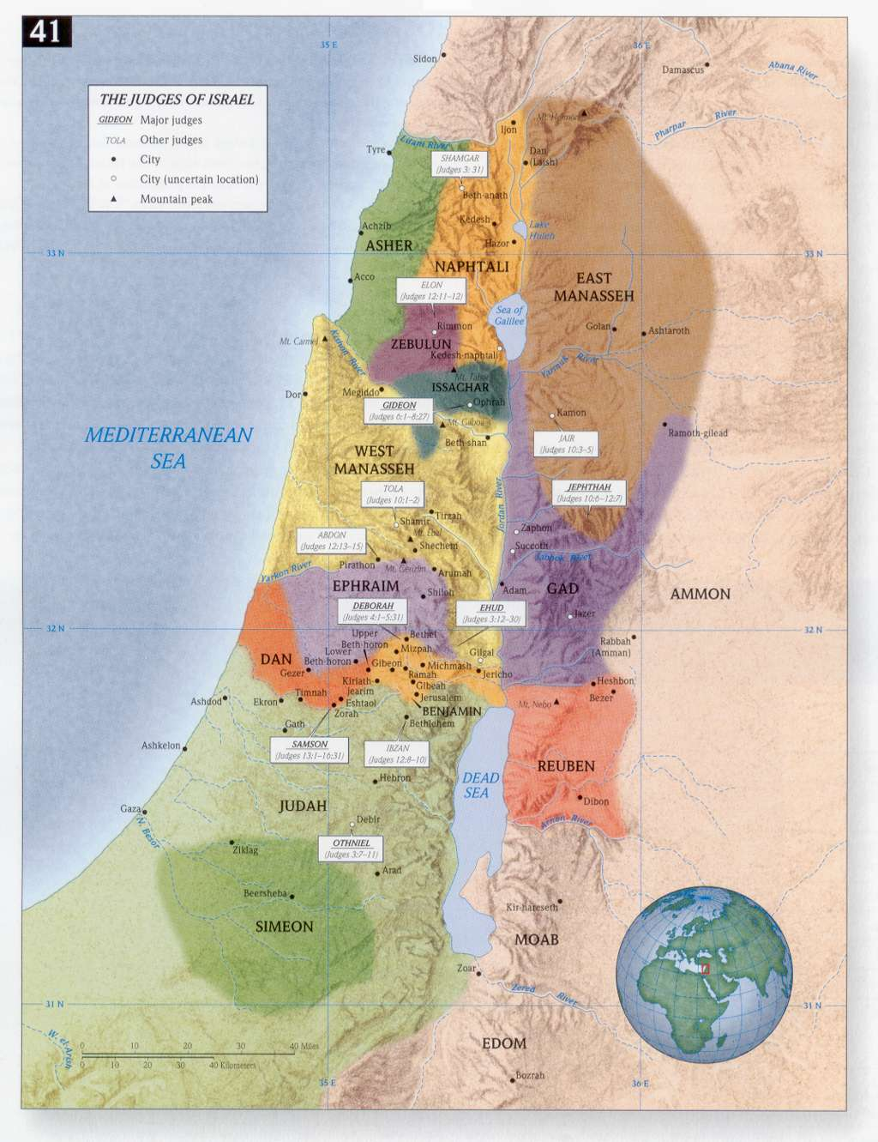
Abimelech
Judges 9
Notes:
Othniel, Ehud, Shamgar, Deborah, Gideon, Abimelech, Tola, Jair, Jephthah, Ibzan, Elon, Abdon, Samson, Eli and Samuel

Slide 7
Patriarchal Age
2700 Years
4219
BC
2563
BC
2136
BC
1921
BC
1491
BC
Antediluvian
(before the flood)‏
Post-
diluvian
Fathers
of
Israel
Egyptian
Bondage
Genesis
Job?
Creation
Flood
Call of
Abraham
7 Year
Famine
The
Exodus
All dates are approximations
Notes:
Adam, Seth, Noah, Shem, Abraham, Isaac, Jacob

Slide 8
Mosaic Age
1400 Years
1491
BC
1451
BC
1400
BC
1095
BC
Wilderness
Wandering
Conquest
of
Canaan
Period of the Judges
Exodus
Judges
Ruth
1Samuel 1-8
Joshua
Leviticus
Numbers
Deuteronomy
The
Exodus
Crossing
Jordan
All dates are approximations
Notes:
Adam, Seth, Noah, Shem, Abraham, Isaac, Jacob
Moses, Joshua
Othniel, Ehud, Shamgar, Deborah, Gideon, Abimelech, Tola, Jair, Jephthah, Ibzan, Elon, Abdon, Samson, Eli and Samuel
Ruth & Boaz

Slide 9
Mosaic Age
1400 Years
1095
BC
975
BC
722
BC
587
BC
537
BC
420
BC
United
Kingdom
Divided
Kingdom
Judah
Alone
Babylonian
Captivity
Jews
Restoration
1Samuel 9-31
2Samuel
1Kings 1-11
1Chronicles
2Chronicles 1-9
1Kings 12-22
2Kings 1-20
2Chronicles 10-32
Esther
Ezra
Nehemiah
2Kings 25
Obadiah
Joel
Jonah
Amos
Hosea
Micah
Isaiah
2Kings 21-25
2Chronicles 33-36
Nahum, Zephaniah
Habakkuk, Jeremiah
Haggai
Zechariah
Malachi
Daniel 6-12
Psalms, Proverbs
Ecclesiastes
Song of Solomon
Daniel 1-5
Ezekiel
Lamentations
Kings
Saul
David
Solomon
Rebellion
Fall
of
Israel
Fall
of
Judah
All dates are approximations

Slide 10
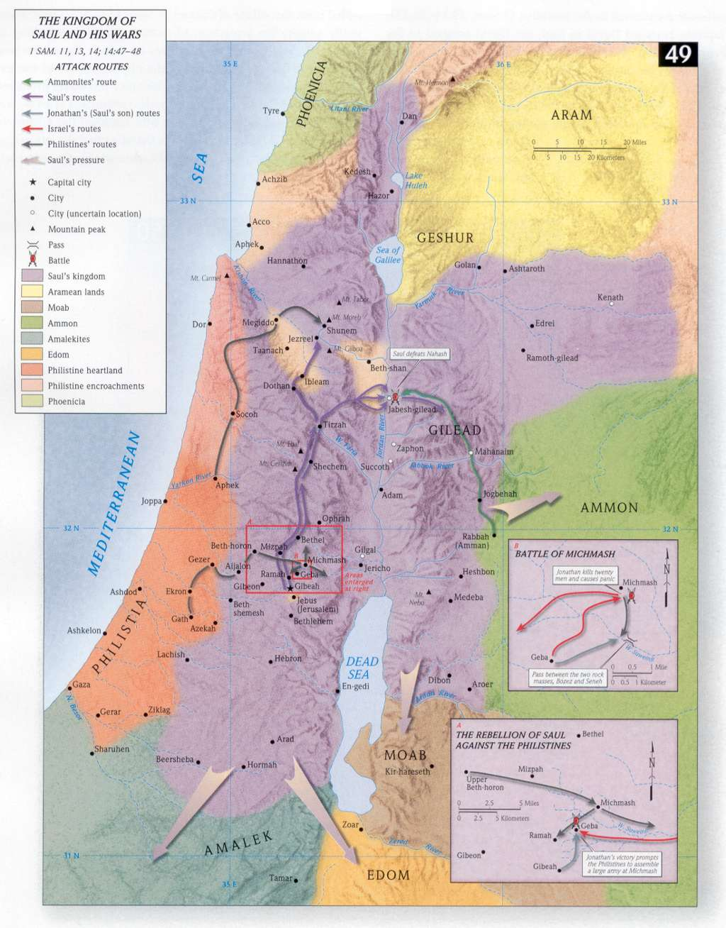

Slide 11
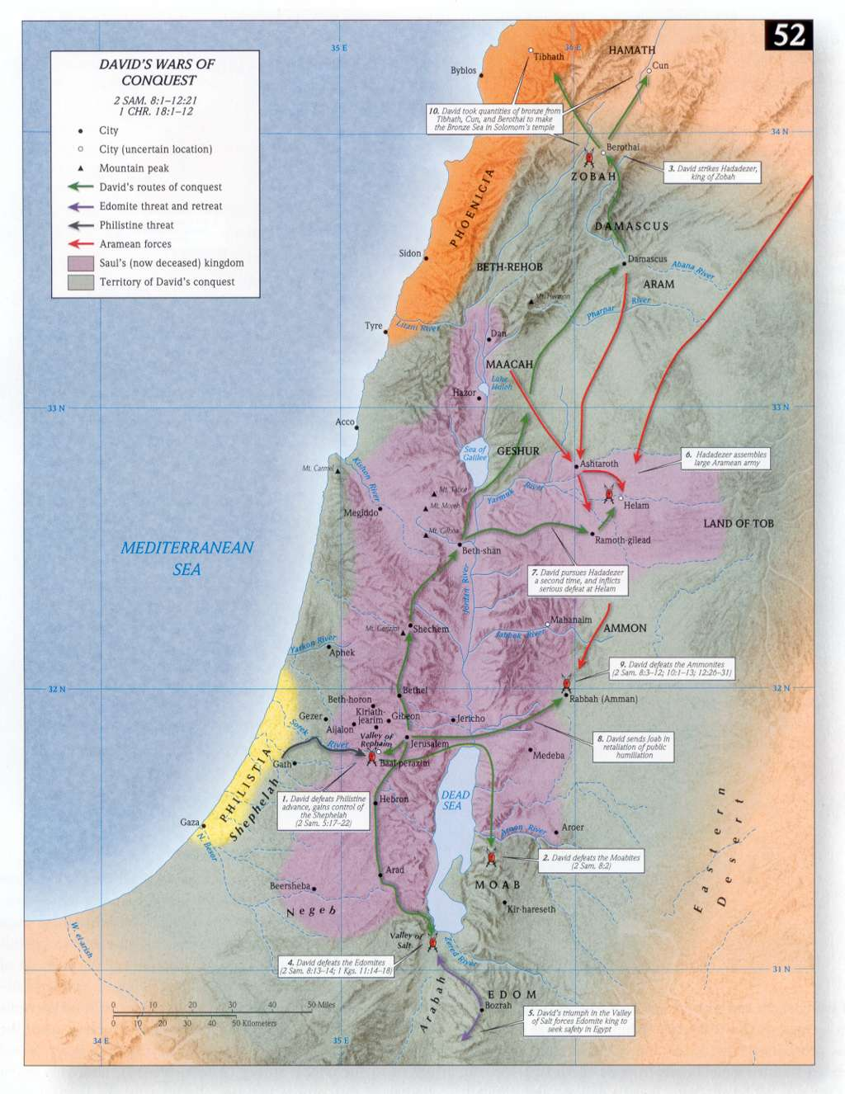

Slide 12
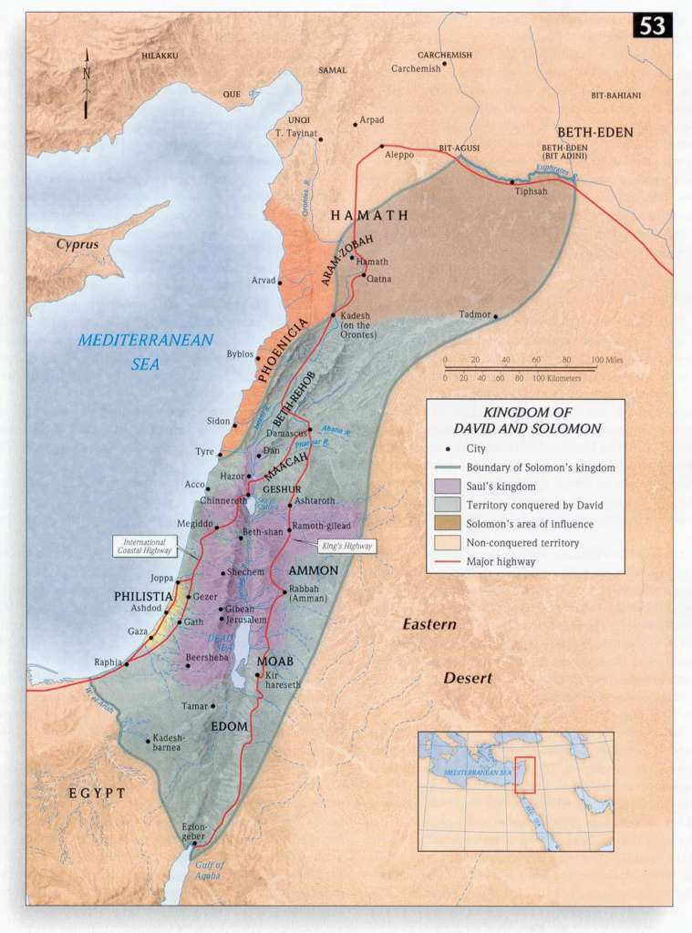

Slide 13
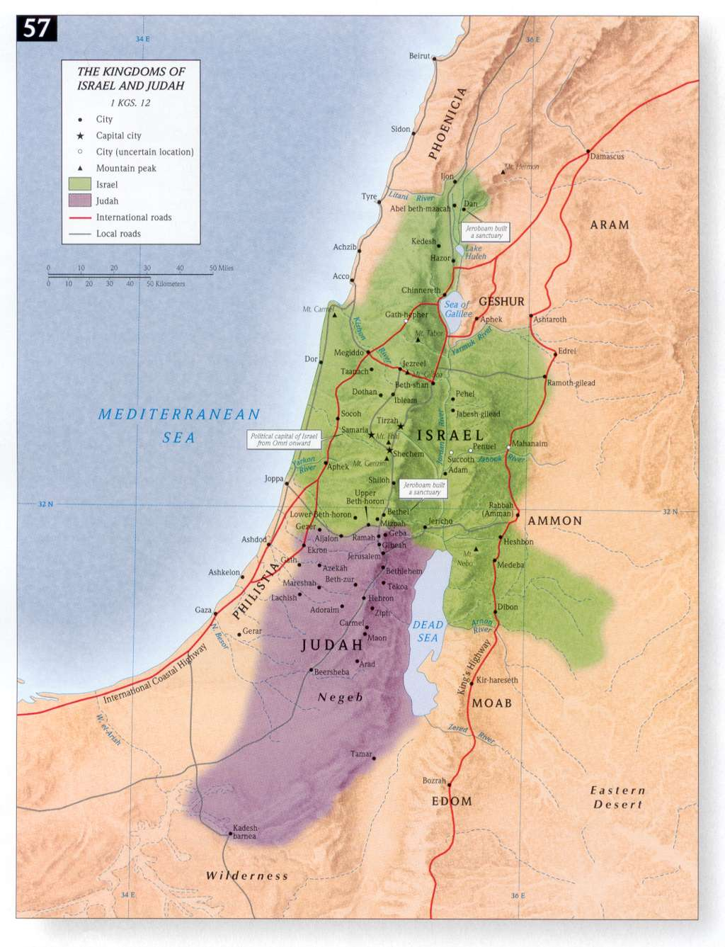

Slide 14
