Slide 1
Patriarchal Age
2700 Years
4219
BC
2563
BC
2091
BC
1876
BC
1446
BC
Antediluvian
(before the flood)‏
Post-
diluvian
Fathers
of
Israel
Egyptian
Bondage
Genesis
Job?
Creation
Flood
Call of
Abraham
7 Year
Famine
The
Exodus
All dates are approximations
Notes:
Adam, Seth, Noah, Shem, Abraham, Isaac, Jacob

Slide 2
Mosaic Age
1400 Years
1446
BC
1406
BC
1361
BC
1050
BC
Wilderness
Wandering
Conquest
of
Canaan
Period of the Judges
Exodus
Judges
Ruth
1Samuel 1-8
Joshua
Leviticus
Numbers
Deuteronomy
The
Exodus
Crossing
Jordan
All dates are approximations
Notes:
Adam, Seth, Noah, Shem, Abraham, Isaac, Jacob
Moses, Joshua
Othniel, Ehud, Shamgar, Deborah, Gideon, Abimelech, Tola, Jair, Jephthah, Ibzan, Elon, Abdon, Samson, Eli and Samuel
Ruth & Boaz

Slide 3
Mosaic Age
1400 Years
1050
BC
930
BC
722
BC
606
BC
536
BC
432
BC
United
Kingdom
Divided
Kingdom
Judah
Alone
Babylonian
Captivity
Jews
Restoration
1Samuel 9-31
2Samuel
1Kings 1-11
1Chronicles
2Chronicles 1-9
1Kings 12-22
2Kings 1-20
2Chronicles 10-32
Esther
Ezra
Nehemiah
2Kings 25
Obadiah
Joel
Jonah
Amos
Hosea
Micah
Isaiah
2Kings 21-25
2Chronicles 33-36
Nahum, Zephaniah
Habakkuk, Jeremiah
Haggai
Zechariah
Malachi
Daniel 6-12
Psalms, Proverbs
Ecclesiastes
Song of Solomon
Daniel 1-5
Ezekiel
Lamentations
Kings
Saul
David
Solomon
Rebellion
Fall
of
Israel
Fall
of
Judah
All dates are approximations
Notes:
Adam, Seth, Noah, Shem, Abraham, Isaac, Jacob
Moses, Joshua
Othniel, Ehud, Shamgar, Deborah, Gideon, Abimelech, Tola, Jair, Jephthah, Ibzan, Elon, Abdon, Samson, Eli and Samuel
Ruth & Boaz
Saul, David, Solomon, Joash, Hezekiah, Josiah
Elijah, Elisha
Daniel
Esther, Ezra, Nehemiah

Slide 4
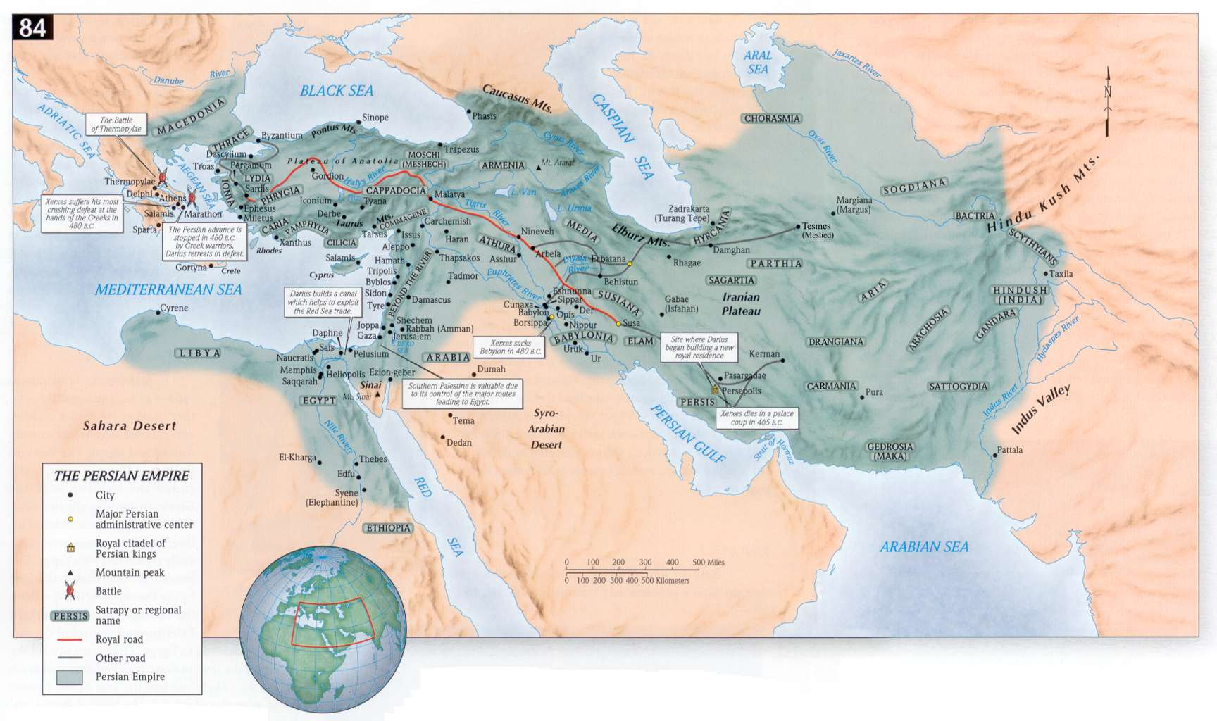

Slide 5
Other Nations
The Captivity Years
633
BC
539
BC
Assyrian
330
BC
Babylonian
63
BC
Medo-Persian
Grecian
Roman
Israel
Judah
722
BC
Israel
Falls
606
BC
Judah
Falls
536
BC
First
Return
458
444
BC
Second
Returns
165
BC
Maccabean
Revolt
432 BC
Malachi
All dates are approximations
Notes:
Adam, Seth, Noah, Shem, Abraham, Isaac, JacobAdam, Seth, Noah, Shem, Abraham, Isaac, Jacob
Moses, Joshua
Othniel, Ehud, Shamgar, Deborah, Gideon, Abimelech, Tola, Jair, Jephthah, Ibzan, Elon, Abdon, Samson, Eli and Samuel
Ruth & Boaz
Saul, David, Solomon, Joash, Hezekiah, Josiah
Elijah, Elisha
Daniel
Esther, Ezra, Nehemiah
Malachi 432 BC

Slide 6
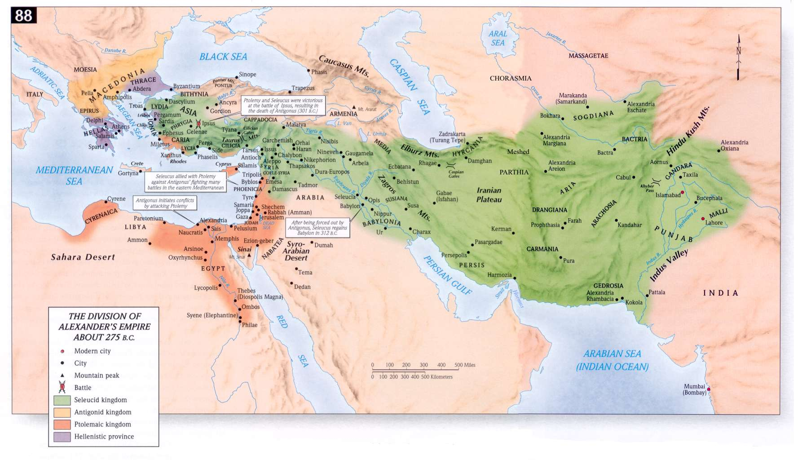

Slide 7
