Slide 1
Our Bibles
Getting our English Text

Slide 2
Material
Early materials
Stone, clay, wood & wax, metal, potsherds
Papryrus
thin wide strip from plant, mainly Egypt
Leather
tanned animal skin
parchment/vellum
stretched & dried small animal skins (sheep, goat, calf)
Notes:
vellum specifically calfskin
Parchment far superior
Much of New testament preserved on parchment.

Slide 3
Arrangement
Scroll
roll of paper or leather up to 35 feet long (length of Matthew or Acts)
Codex
leaves bound together much like our books today
May be Christian innovation for purpose of distributing the word.

Slide 4
Languages
Hebrew
Almost all of Old Testament
Aramaic
Few small passages in OT
Daniel 2:4b-7:8
Greek
All of New Testament
Koine (common)
Notes:
Several of Jesus' expressions are aramaic notable Mk 15:34
NT greek particularly Koine (common) the universal language of the 1st century
copied by hand each time. Romans employed a number of scribes copying as text was read aloud to them, thus making many copies at a time, 1 scribe = 1 copy still though.

Slide 5
Types
Autographs
Originals from the author
Manuscripts
Copies in original language
Versions
Translations
Writings
Commentaries, Sermons, etc.
Notes:
No autographs survive
~5,300 manuscripts
In total over 20,000 kinds of text are known now

Slide 6
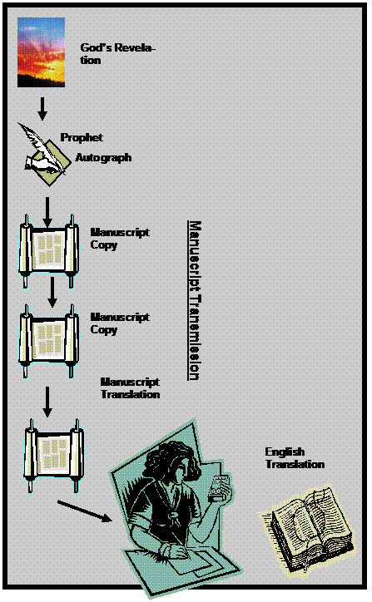
Earth
Original
Original
Language
Copies
Language
Translation

Slide 7
Unicals
UNICALS
all caps no spaces
~650
95 papyri
270 lectionaries (for public readings)
280 parchment
Notes:
Vatican Manuscript - 4th century cataloged 1481 first available 1867 pub 1890
From Gen 46:28 to Heb 9:14, James-Jude, except Psa 106-138, Timothy, Titus & Revelation
Mk 16:9-20 not written but space left sufficient for its inclusion
Sinaitic Manuscript - 4th century first available 1862 pub 1933
complete NT
Alexandrian Manuscript - 5th century 1627
almost all of both Old & New missing Mt 1:1-25:6; Jhn 6:50-8:52; 2Cor 4:13-12:6

Slide 8
Example
PAULASERVANTOFJESUSCHRISTCALLEDTOBEANAPOSTLESETAPARTFORTHEGOSPELOFGODWHICHHEPROMISEDBEFOREHANDTHROUGHHISP

Slide 9
Example
PAULASERVANTOFJESUSCHRISTCALLEDTOBEANAPOSTLESETAPARTFORTHEGOSPELOFGODWHICHHEPROMISEDBEFOREHANDTHROUGHHISP

Slide 10
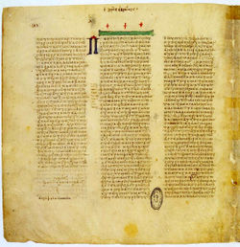
Notes:
Vatican codex - unical

Slide 11
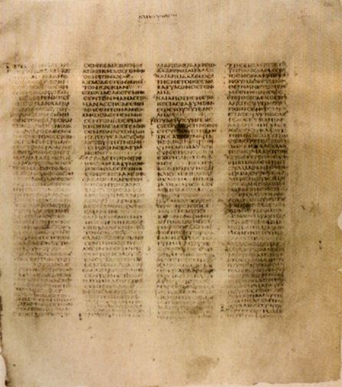
Notes:
Sinaitic codex unical

Slide 12
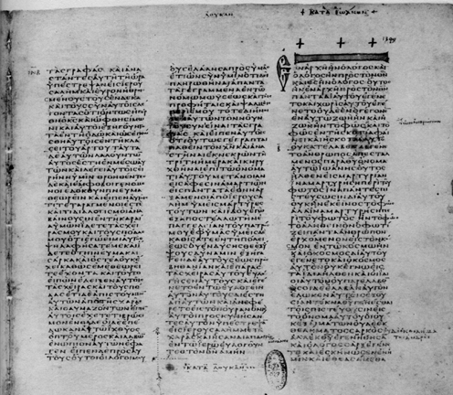
Notes:
Vatican codex

Slide 13
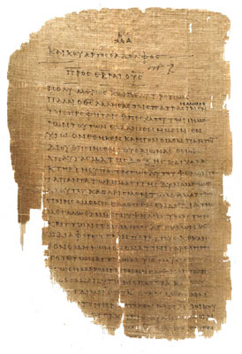
Notes:
Codex fragment

Slide 14
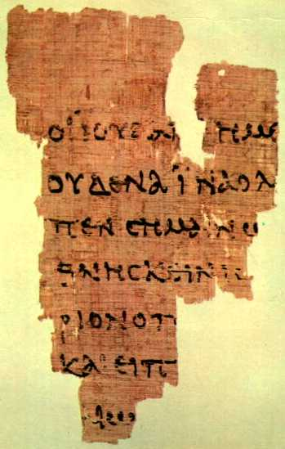
Notes:
John Rylands fragment front side

Slide 15
Variants
Acts 18:24
Apollos
Apelles
Apollonios
John 1:28
Bethabara beyond Jordan
Bethany beyond Jordan
Matthew 1:18
Birth of Jesus Christ
Birth of Christ Jesus
Notes:
Consequences of Variations p 96 “How We Got The Bible”

Slide 16
Variants
No Effect
Jhn 7:53-8:11
Acts 8:37
1Jhn 5:7
Could Effect
Mk 16:9-20
Notes:
Consequences of Variations p 96 “How We Got The Bible”

Slide 17
KJV 1 John 5:6-8 ESV
6 And it is the Spirit that beareth witness, because the Spirit is truth.
7 For there are three that bear record in heaven, the Father, the Word, and the Holy Ghost: and these three are one.
8 And there are three that bear witness in earth, the Spirit, and the water, and the blood: and these three agree in one.
6 And the Spirit is the one who testifies, because the Spirit is the truth.
7 For there are three that testify:
8 the Spirit and the water and the blood; and these three agree.

Slide 18
KJV 1 John 5:6-8 ASV
6 And it is the Spirit that beareth witness, because the Spirit is truth.
7 For there are three that bear record in heaven, the Father, the Word, and the Holy Ghost: and these three are one.
8 And there are three that bear witness in earth, the Spirit, and the water, and the blood: and these three agree in one.
7 And it is the Spirit that beareth witness, because the Spirit is the truth.
8 For there are three who bear witness, the Spirit, and the water, and the blood: and the three agree in one.

Slide 19
Types
Autographs
Originals from the author
Manuscripts
Copies in original language
Versions
Translations
Writings
Commentaries, Sermons, etc.
Notes:
No autographs survive
~5,300 manuscripts
In total over 20,000 kinds of text are known now

Slide 20
Order of Importance
Manuscripts
Versions
Writings
Notes:
Professor Bruce Metzger
"so extensive are these citations that if all other sources for our knowledge of the text of the New Testament were destroyed, they would be sufficient alone for the reconstruction of practically the entire New Testament."

Slide 21
Most Valuable
Vatican Manuscript
4th century cataloged 1481 first available 1867 pub 1890
Sinaitic Manuscript
4th century first available 1862 pub 1933
Alexandrian Manuscript
5th century 1627
Notes:
Vatican Manuscript - 4th century cataloged 1481 first available 1867 pub 1890
From Gen 46:28 to Heb 9:14, James-Jude, except Psa 106-138, Timothy, Titus & Revelation
Mk 16:9-20 not written but space left sufficient for its inclusion
Sinaitic Manuscript - 4th century first available 1862 pub 1933
complete NT
Alexandrian Manuscript - 5th century 1627
almost all of both Old & New missing Mt 1:1-25:6; Jhn 6:50-8:52; 2Cor 4:13-12:6

Slide 22
Beginning of Common
First Greek NT in 1516
Erasmus from few late greek manuscripts available, none of the early unicals
Stephanus & others revised through 1633 known as "Received Text"
Westcott-Hort text 1881
able to use Vatican & Sinaitic as well as many other new discoveries not available to Erasmus & Stephanus

Slide 23
English Versions
Wycliffe 1382 from Latin
Tyndale 1526 from Greek
Coverdale 1535
Great Bible 1539
Geneva Bible 1560
Bishops Bible 1568
Catholic version
Rheims NT 1582 - Douai OT 1610
Notes:
Wycliffe 1382 from Latin
Tyndale 1526 from Greek
Coverdale 1535
Great Bible 1539
(Preachers complained that people wanted to hear reading of Bible instead of their sermons)
Geneva Bible 1560
included commentary of John Calvin & reformation
Bishops Bible 1568
Catholic version Rheims NT 1582 - Douai OT 1610

Slide 24
Current Versions
King James 1611
English Revised 1885
American Standard 1901
Revised Standard 1946/1952
N Revised Standard 1990
N American Standard 1963/1971
N American Standard update 1995
N King James 1979/1982
English Standard 2001/2007/2011
Notes:
King James 1611
Very scholarly work, revision of Bishops Bible 48 Greek & Hebrew scholars almost 3 yrs
no commentary!
Over 80% of KJV is Tyndale's translation
It was not a start over from scratch as some have presented it
English Revised 1885
English revision of KJV followed British line of thinking similar scholarship to KJV but used old manuscripts also
American Standard 1901
English revision of KJV followed American line of thinking
Revised Standard NT 1946 OT 1952
Another revision of KJV
New Revised Standard 1990
New American Standard NT 1963 OT 1971
Revision to bring ASV back into public focus
NKJV 1979
2 editions - discovered the minor changes of thee, thou etc. would not allow them to copyright the text, so they revised more to be sufficient to copyright.

Slide 25
Tyndale/KJV
English Revised
American Standard
Revised Standard
New American Standard
New King James
New Revised Standard
English Standard
Notes:
Attempt to show what came from where. ☺

Slide 26
Which One?
Notes:
Generally speaking newer translations done with better resources, more access to earlier texts & more texts. Revision done by many scholars working together. These things lead to a more accurate text.
Do You Know My Jesus?

