Slide 1
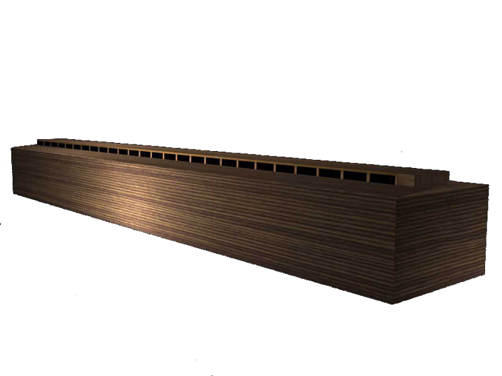
The Ark Is A Shadow
Hebrews 11:7

Slide 2
Ark Church
One
Genesis 6:14
Ephesians 4:4-6
Ephesians 1:22-23

Slide 3
Ark Church
One
Builder
Genesis 6:13
Matthew 16:18

Slide 4
Ark Church
One
Builder
Construction
Genesis 6:14
Acts 11:26
1Peter 2:4-5

Slide 5
Ark Church
One
Builder
Construction
Door
Genesis 6:16-7:1
John 10:9

Slide 6
Ark Church
One
Builder
Construction
Door
Light
Genesis 6:16
John 1:9,14
Psalms 119:105
1John 1:5-7

Slide 7
Ark Church
One
Builder
Construction
Door
Light
Family
Genesis 7:7
Ephesians 3:14-15
Galatians 3:26
Romans 8:14-17

Slide 8
Ark Church
One
Builder
Construction
Door
Light
Family
Name
Genesis 6:13; 7:1,7,5
Acts 4:12; 11:26

Slide 9
All Else Is LOST!
Genesis 7:23
Revelation 20:14-15
Revelation 21:8

