Slide 1
Trusting The Text
2Peter 1:16-21

Slide 2
Getting The Text
Scripture Was Promised
John 14:26
2Peter 1:15
2Peter 3:15-16
Colossians 4:16
Ephesians 3:1-5
2Timothy 4:13

Slide 3
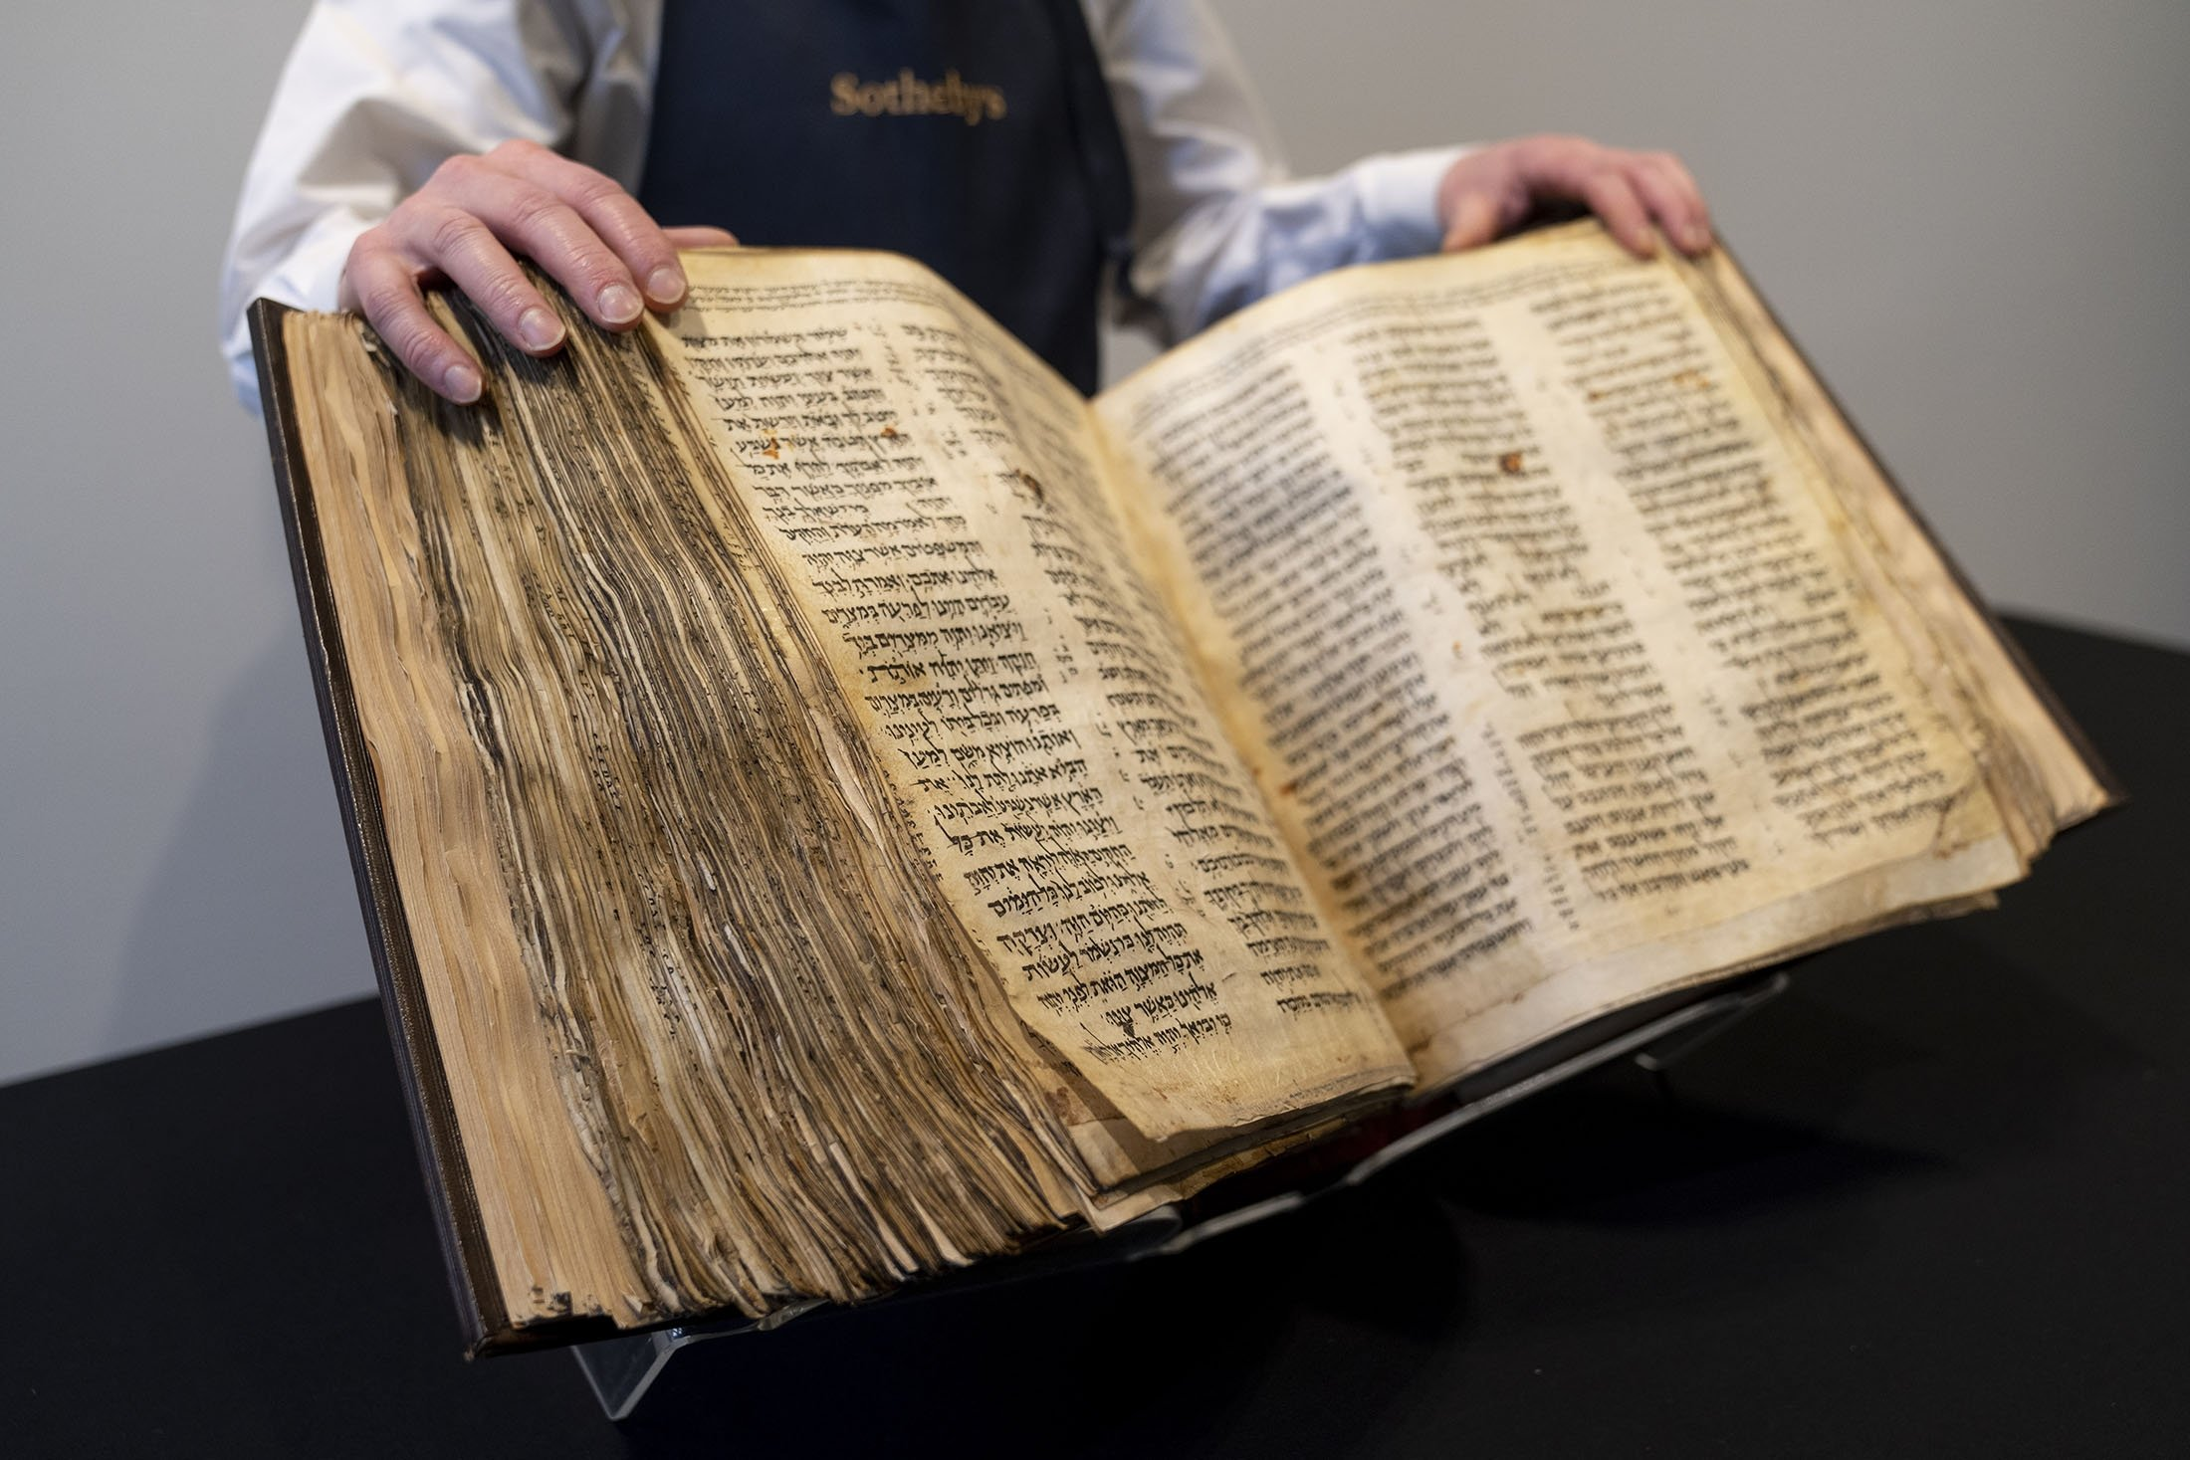
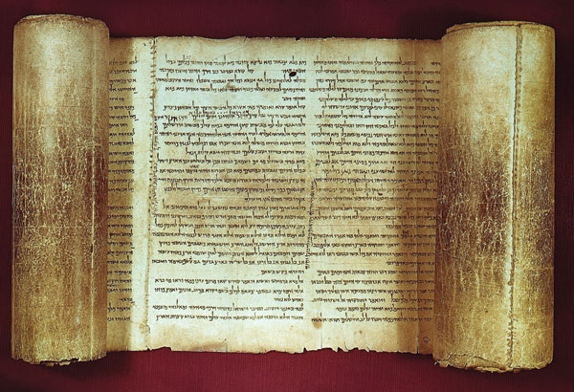
Getting The Text
Scripture Was Promised
Not Just Paper And Ink
Papryrus & Parchment
Scroll & Codex
Hebrew, Greek, Aramaic
Daniel 2:4b-7:8
Mark 15:34

Slide 4
Getting The Text
Scripture Was Promised
Not Just Paper And Ink
Gathered Together
Vatican – 4th century
Sinaitic – 4th century
Alexandrian – 5th century
No Originals (Autographs)
~5,300 Greek Manuscripts
~280 Parchment
~13,000 Minuscules

Slide 5
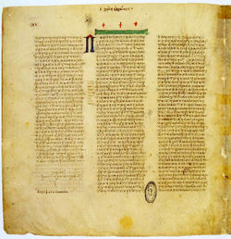
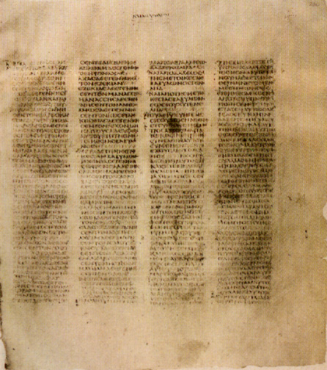
Notes:
Vatican codex - unical

Slide 6
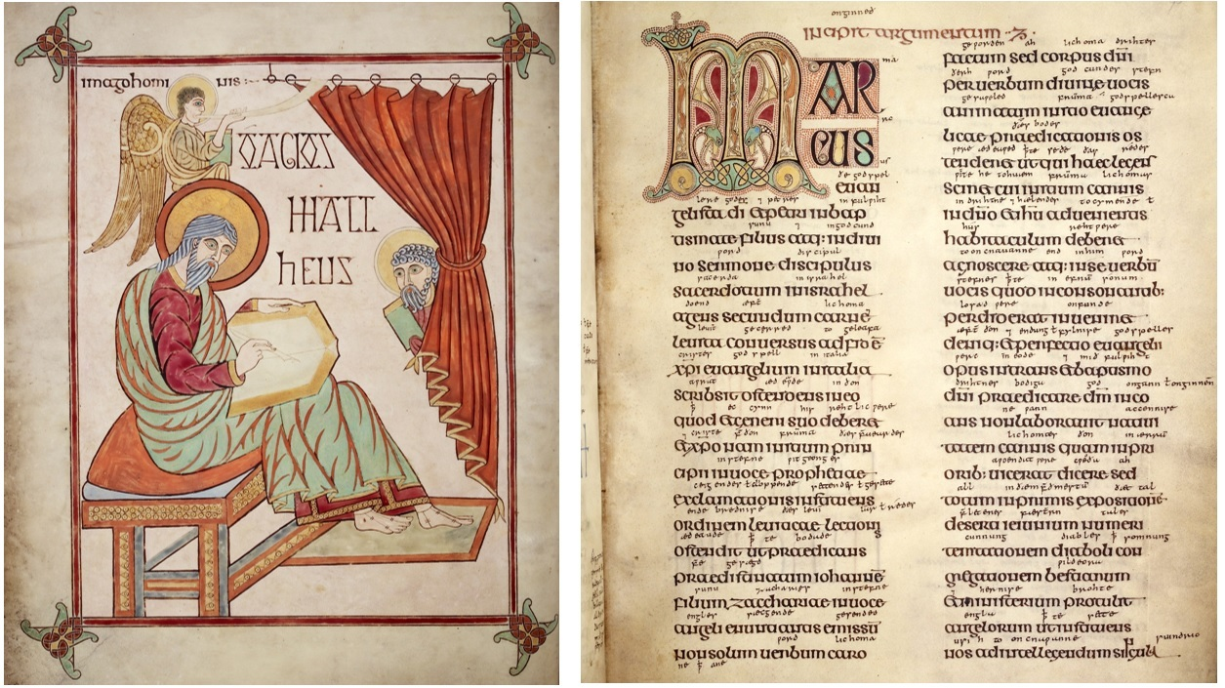
Notes:
Vatican codex - unical

Slide 7
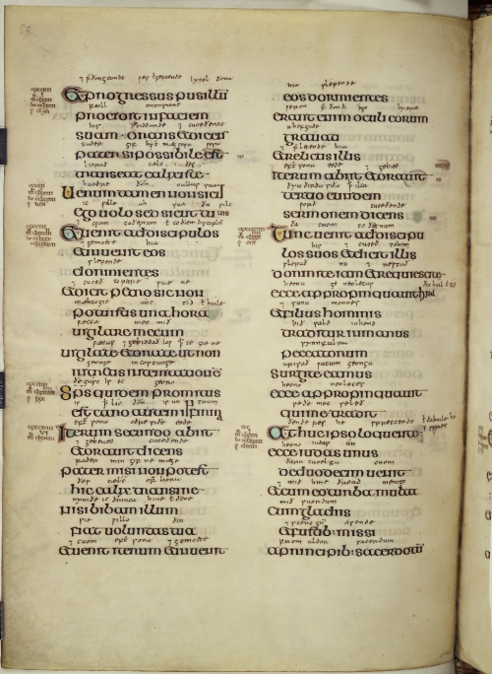
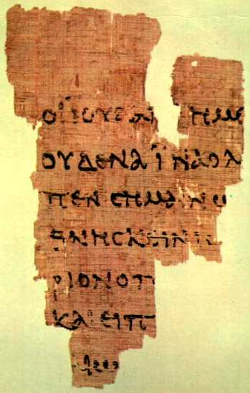
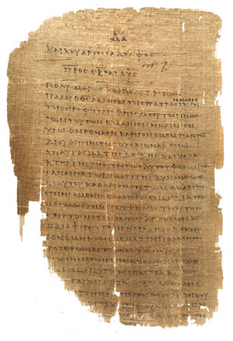
Notes:
Sinaitic codex unical

Slide 8
Getting The Text
Scripture Was Promised
Not Just Paper And Ink
Gathered Together
Greek To Me
John 7:53-8:11
Acts 8:37
1John 5:7
Mark 16:9-20

Slide 9
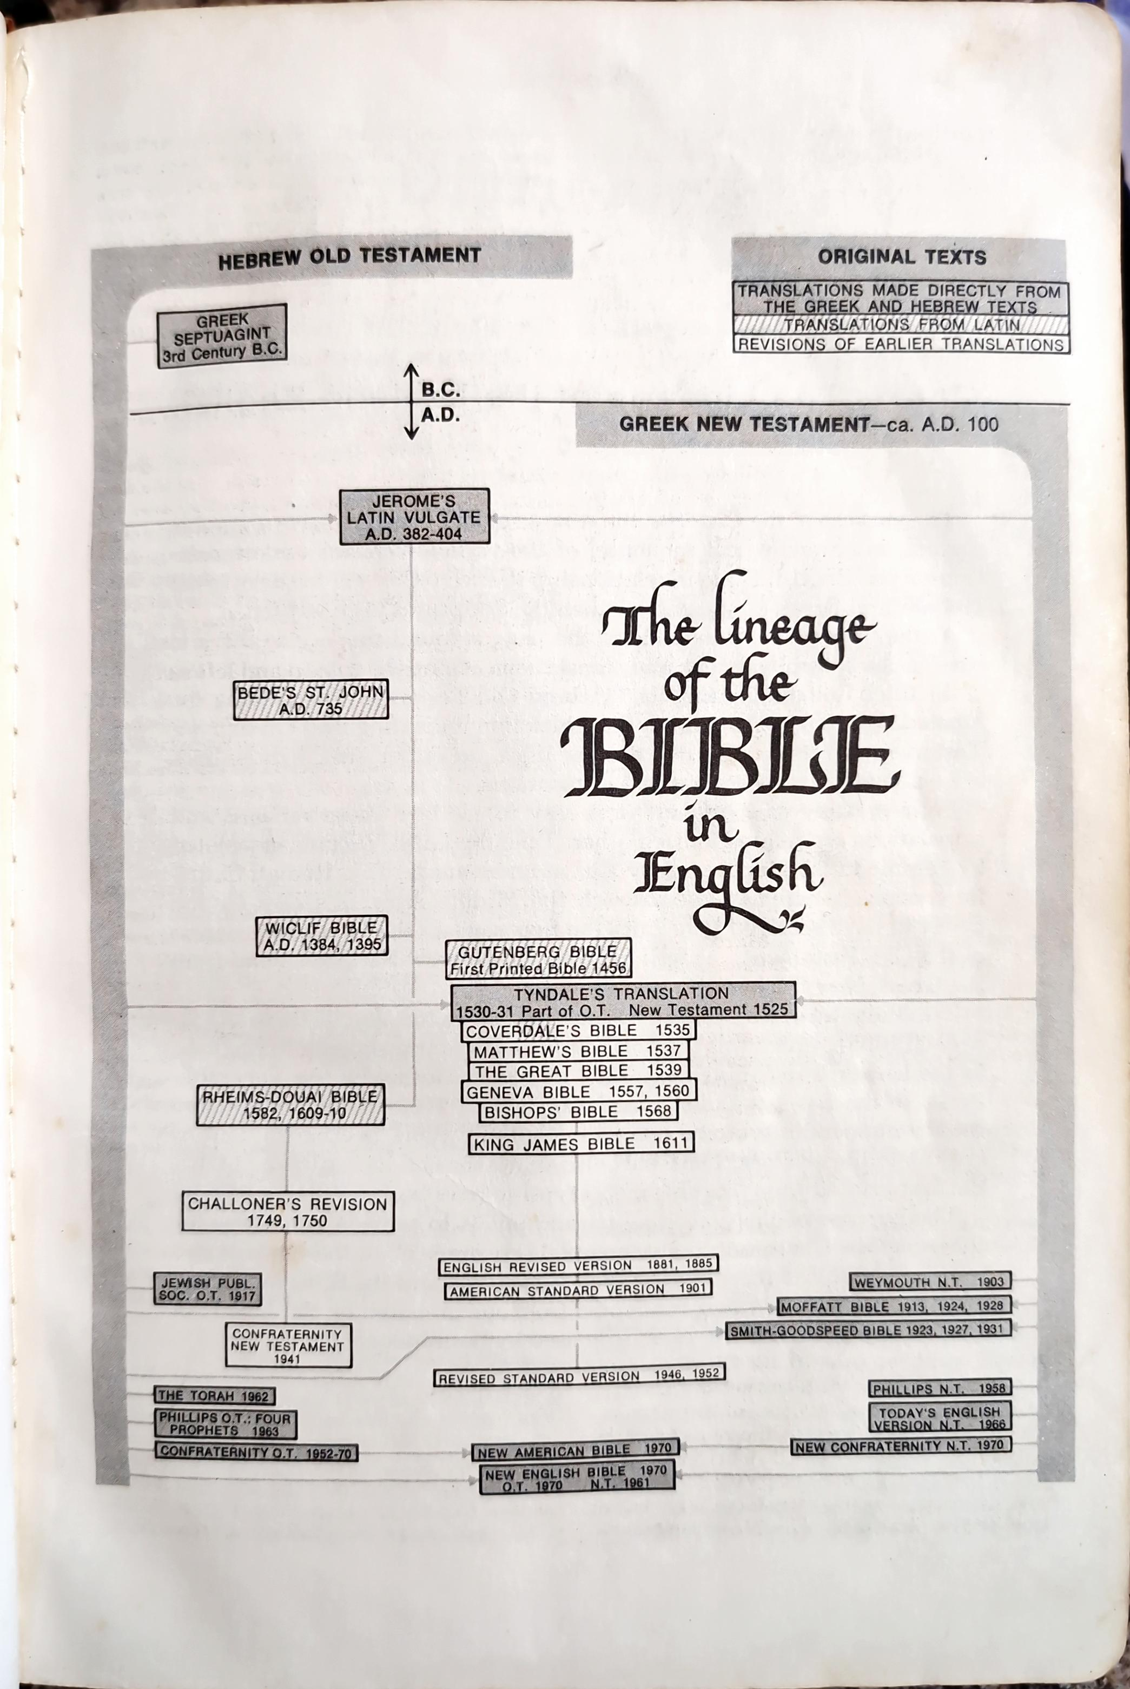

Slide 10
Getting The Text
Scripture Was Promised
Not Just Paper And Ink
Gathered Together
Greek To Me
First English versions
2Peter 1:15

