Slide 2
2 Timothy 3:16-17 – “All Scripture is breathed out by God and profitable for teaching, for reproof, for correction, and for training in righteousness, 17 that the man of God may be complete, equipped for every good work.”

Slide 3
2 Timothy 3:16-17 – “All Scripture is breathed out by God and profitable for teaching, for reproof, for correction, and for training in righteousness, 17 that the man of God may be complete, equipped for every good work.”

Slide 4
2 Timothy 3:16-17 – “All Scripture is breathed out by God and profitable for teaching, for reproof, for correction, and for training in righteousness, 17 that the man of God may be complete, equipped for every good work.”

Slide 5
2 Timothy 3:16-17 – “All Scripture is breathed out by God and profitable for teaching, for reproof, for correction, and for training in righteousness, 17 that the man of God may be complete, equipped for every good work.”

Slide 6
The Bible is a human product reflecting spiritual insight and moral wisdom but is not divine revelation. The Bible contains myth, legend, and historical inaccuracies.
Liberal
Five approaches to viewing scripture

Slide 7
The bible is the inerrant and infallible word of God in all matters – doctrinal, moral, historical, and scientific.
Liberal
Fundamentalist
Five approaches to viewing scripture

Slide 8
Neo-orthodoxy sees Jesus, not scripture, as “the word of God” and views the Bible as man’s interpretation of Jesus’ actions.
Liberal
Neo-orthodox
Fundamentalist
Five approaches to viewing scripture

Slide 9
Holds to the core fundamentalists belief such as
inerrancy but takes a more nuanced approach.
Liberal
Neo-orthodox
Evangelical
Fundamentalist
Five approaches to viewing scripture

Slide 10
Scripture is understood through authoritative tradition. Confessions and creeds equally or in some cases are more authoritative than scripture itself.
Traditionalist
Liberal
Neo-orthodox
Evangelical
Fundamentalist
Five approaches to viewing scripture

Slide 11
Traditionalist
Liberal
Neo-orthodox
Evangelical
Fundamentalist
Five approaches to viewing scripture

Slide 12
Traditionalist
Liberal
Neo-orthodox
Evangelical
Fundamentalist
Five approaches to viewing scripture

Slide 13
Traditionalist
Liberal
Neo-orthodox
Evangelical
Fundamentalist
Five approaches to viewing scripture

Slide 14
Traditionalist
Liberal
Neo-orthodox
Evangelical
Fundamentalist
Five approaches to viewing scripture

Slide 15
Traditionalist
Liberal
Neo-orthodox
Evangelical
Fundamentalist
Five approaches to viewing scripture

Slide 16
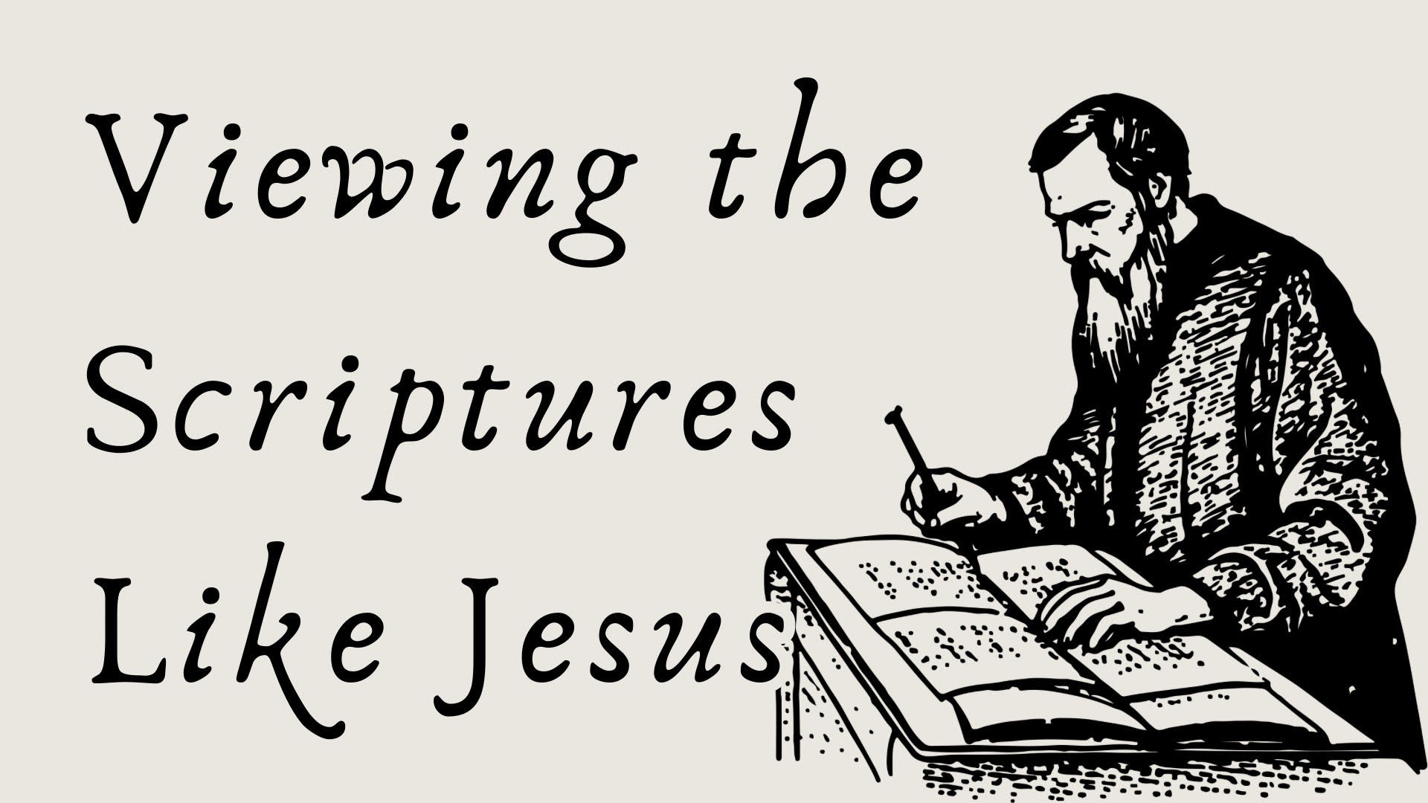

Slide 17

Viewing the Scriptures Like Jesus
Jesus believed scripture was inspired by God.
2 Peter 1:20-21 – “…knowing this first of all, that no prophecy of Scripture comes from someone's own interpretation. For no prophecy was ever produced by the will of man, but men spoke from God as they were carried along by the Holy Spirit.”

Slide 18
Viewing the Scriptures Like Jesus
Jesus believed scripture was inspired by God.
Mark 12:35, 36 – “And as Jesus taught in the temple, he said, “How can the scribes say that the Christ is the son of David? David himself, in the Holy Spirit, declared, “‘The Lord said to my Lord, “Sit at my right hand, until I put your enemies under your feet.”’

Slide 19
Viewing the Scriptures Like Jesus
Jesus believed scripture was inspired by God.
Mark 12:35, 36 – “And as Jesus taught in the temple, he said, “How can the scribes say that the Christ is the son of David? David himself, in the Holy Spirit, declared, “‘The Lord said to my Lord, “Sit at my right hand, until I put your enemies under your feet.”’

Slide 20
Viewing the Scriptures Like Jesus
Jesus believed scripture was inspired by God.
Matthew 19:4-5 – “He answered, “Have you not read that he who created them from the beginning made them male and female, 5 and said, ‘Therefore a man shall leave his father and his mother and hold fast to his wife, and the two shall become one flesh’?”

Slide 21
Viewing the Scriptures Like Jesus
Jesus believed scripture was inerrant and infallible.
John 10:34-36 – “Jesus answered them, “Is it not written in your Law, ‘I said, you are gods’? 35 If he called them gods to whom the word of God came—and Scripture cannot be broken— 36 do you say of him whom the Father consecrated and sent into the world, ‘You are blaspheming,’ because I said, ‘I am the Son of God’?”

Slide 22
Viewing the Scriptures Like Jesus
Jesus believed scripture was inerrant and infallible.
John 10:34-36 – “Jesus answered them, “Is it not written in your Law, ‘I said, you are gods’? 35 If he called them gods to whom the word of God came—and Scripture cannot be broken— 36 do you say of him whom the Father consecrated and sent into the world, ‘You are blaspheming,’ because I said, ‘I am the Son of God’?”

Slide 23
Viewing the Scriptures Like Jesus
Jesus believed scripture was inerrant and infallible.
Matthew 5:17-18 – “Do not think that I have come to abolish the Law or the Prophets; I have not come to abolish them but to fulfill them. 18 For truly, I say to you, until heaven and earth pass away, not an iota, not a dot, will pass from the Law until all is accomplished.”

Slide 24

Viewing the Scriptures Like Jesus
Jesus believed scripture was inerrant and infallible.

Slide 25


Viewing the Scriptures Like Jesus
Jesus believed scripture was inerrant and infallible.

Slide 26
Viewing the Scriptures Like Jesus
Jesus believed scripture was inerrant and infallible.
Matthew 22:23-33

Slide 27
Viewing the Scriptures Like Jesus
Jesus believed scripture was authoritative.
John 17:17 – “Sanctify them in
the truth. Your Word is truth.”

Slide 28
Viewing the Scriptures Like Jesus
Jesus believed scripture was authoritative.
Matthew 4:1-11

Slide 29
Viewing the Scriptures Like Jesus
Jesus believed scripture was authoritative.
John 5:30 – “I can do nothing on my own. As I hear, I judge, and my judgment is just, because I seek not my own will but the will of him who sent me.”

Slide 30
Viewing the Scriptures Like Jesus
Jesus believed scripture was authoritative.
John 8:28 – “So Jesus said to them, “When you have lifted up the Son of Man, then you will know that I am he, and that I do nothing on my own authority, but speak just as the Father taught me.”

Slide 31
Viewing the Scriptures Like Jesus
Jesus believed scripture was authoritative.
Matthew 26:50-54

Slide 32
Viewing the Scriptures Like Jesus
Jesus believed scripture as historically accurate.
Creation
Mark 10:6 – “But from the beginning of
creation, ‘God made them male and female.”

Slide 33
Viewing the Scriptures Like Jesus
Jesus believed scripture as historically accurate.
The Flood
Matthew 24:38–39 – “For as in those days before the flood they were eating and drinking, marrying and giving in marriage, until the day when Noah entered the ark, 39 and they were unaware until the flood came and swept them all away, so will be the coming of the Son of Man.”

Slide 34
Viewing the Scriptures Like Jesus
Jesus believed scripture as historically accurate.
The destruction of Sodom and Gomorrah
Luke 17:28-29 – “Likewise, just as it was in the days of Lot—they were eating and drinking, buying and selling, planting and building, 29 but on the day when Lot went out from Sodom, fire and sulfur rained from heaven and destroyed them all—

Slide 35
Viewing the Scriptures Like Jesus
Jesus believed scripture as historically accurate.
Jonah and the Great Fish
Matthew 12:40 – “For just as Jonah was three days and three nights in the belly of the great fish, so will the Son of Man be three days and three nights in the heart of the earth.”

Slide 36
Viewing the Scriptures Like Jesus
Jesus believed scripture founds its fulfillment in Him.
John 5:39 – “You search the Scriptures because you think that in them you have eternal life; and it is they that bear witness about me…”

Slide 37
Viewing the Scriptures Like Jesus
Jesus believed scripture found its fulfillment in Him.
John 5:46 – “For if you believed Moses,
you would believe me; for he wrote of me.”

Slide 38
Viewing the Scriptures Like Jesus
Jesus believed scripture found its fulfillment in Him.
Luke 24:44 – “Then he said to them, “These are my words that I spoke to you while I was still with you, that everything written about me in the Law of Moses and the Prophets and the Psalms must be fulfilled.”

Slide 39
Viewing the Scriptures Like Jesus
Jesus believed scripture found its fulfillment in Him.
Matthew 5:17 – “Do not think that I have
come to abolish the Law or the Prophets; I have
not come to abolish them but to fulfill them.”

Slide 40
Viewing the Scriptures Like Jesus
Scripture is inspired by God.
Scripture is inerrant and infallible.
Scripture is authoritative over life.
Scripture is historically accurate.
Scripture finds its fulfillment in Jesus.

Slide 41
Viewing the Scriptures Like Jesus
Scripture is inspired by God.
Scripture is inerrant and infallible.
Scripture is authoritative over life.
Scripture is historically accurate.
Scripture finds its fulfillment in Jesus.

Slide 42
Viewing the Scriptures Like Jesus
Scripture is inspired by God.
Scripture is inerrant and infallible.
Scripture is authoritative over life.
Scripture is historically accurate.
Scripture finds its fulfillment in Jesus.

Slide 43
Viewing the Scriptures Like Jesus
Scripture is inspired by God.
Scripture is inerrant and infallible.
Scripture is authoritative over life.
Scripture is historically accurate.
Scripture finds its fulfillment in Jesus.

Slide 44
Viewing the Scriptures Like Jesus
Scripture is inspired by God.
Scripture is inerrant and infallible.
Scripture is authoritative over life.
Scripture is historically accurate.
Scripture finds its fulfillment in Jesus.

Slide 45
Viewing the Scriptures Like Jesus
Scripture is inspired by God.
Scripture is inerrant and infallible.
Scripture is authoritative over life.
Scripture is historically accurate.
Scripture finds its fulfillment in Jesus.

