Slide 2
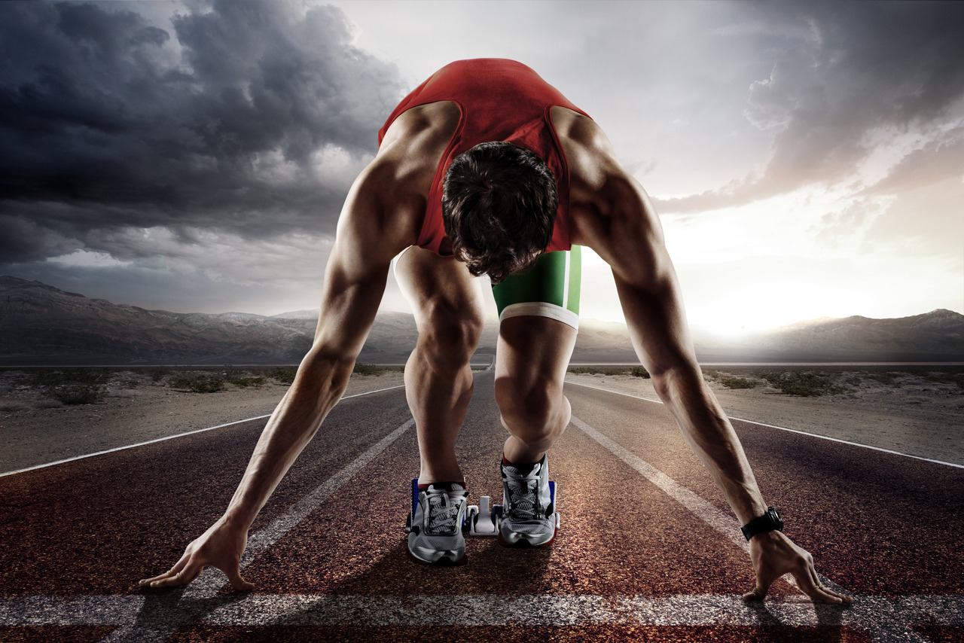
Weights that Hinder Running
1 Corinthians 10:23 – “All things are lawful,” but not all things are helpful. “All things are lawful,” but not all things build up.

Slide 3
Weights that Hinder Running
Hebrews 12:1 – “Therefore, since we are surrounded by so great a cloud of witnesses let us lay aside every weight and sin which clings so closely, and let us run with endurance the race that is set before us…”

Slide 4
Weights that Hinder Running
Hebrews 12:1 – “Therefore, since we are surrounded by so great a cloud of witnesses let us lay aside every weight and sin which clings so closely, and let us run with endurance the race that is set before us…”

Slide 5
Weights that Hinder Running
Hebrews 12:1 – “Therefore, since we are surrounded by so great a cloud of witnesses let us lay aside every weight and sin which clings so closely, and let us run with endurance the race that is set before us…”

Slide 6
Weights that Hinder Running
Apotithemi = “lay aside”
Apo = away
Tithemi = to place or lay something down

Slide 7
Weights that Hinder Running
Hebrews 12:1 – “Therefore, since we are surrounded by so great a cloud of witnesses let us lay aside every weight and sin which clings so closely, and let us run with endurance the race that is set before us…”

Slide 8
Weights that Hinder Running
A standard of measurement:
5 Questions
Question #1: Can I do this for God’s glory?

Slide 9
Weights that Hinder Running
A standard of measurement:
5 Questions
Question #2: Does this draw me closer to God or does it draw me closer to the world?

Slide 10
Weights that Hinder Running
A standard of measurement:
5 Questions
Question #3: Does this keep me from fulfilling my spiritual responsibilities?

Slide 11
Weights that Hinder Running
A standard of measurement:
5 Questions
Question #4: Am I giving too much time/energy/money to this?

Slide 12
Weights that Hinder Running
A standard of measurement:
5 Questions
Question #5: Does this rival my love and affection for God?

Slide 13
Weights that Hinder Running
The weight of cell phone usage:
Can I do this for God’s glory?

Slide 14
Weights that Hinder Running
The weight of cell phone usage:
Can I do this for God’s glory?
Does this draw me closer to God?

Slide 15
Weights that Hinder Running
The weight of cell phone usage:
Can I do this for God’s glory?
Does this draw me closer to God?
Does this stop me from fulfilling responsibility.

Slide 16
Weights that Hinder Running
The weight of cell phone usage:
Can I do this for God’s glory?
Does this draw me closer to God?
Does this stop me from fulfilling responsibility.
Am I giving too many resources to this?

Slide 17
Weights that Hinder Running
The weight of cell phone usage:
Can I do this for God’s glory?
Does this draw me closer to God?
Does this stop me from fulfilling responsibility.
Am I giving too many resources to this?
Does this rival my love and affection for God?

